Slide 1

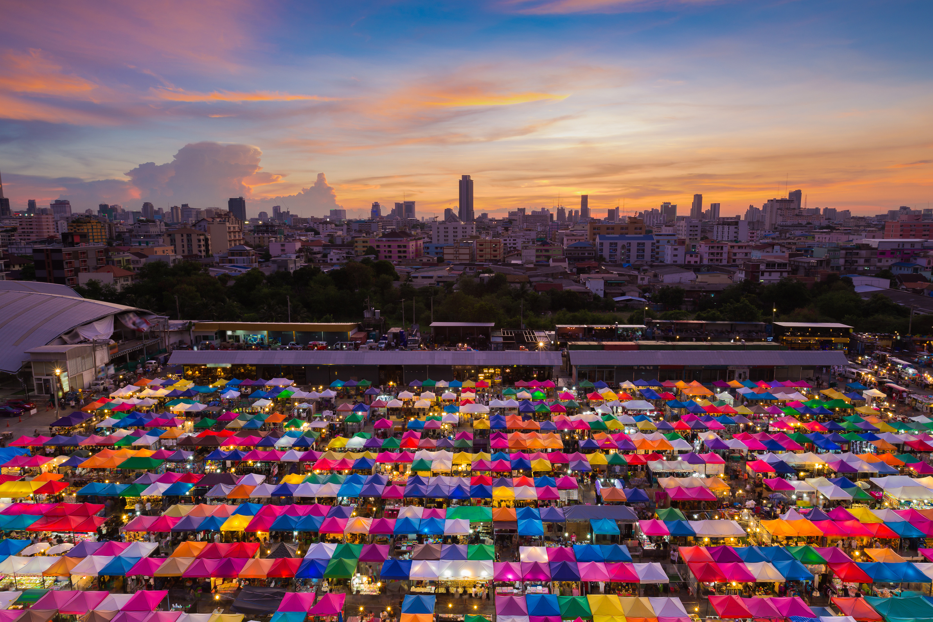

Chnaxe Solutions
Invites You to Experience the Ultimate Display of Art and Skill on Weekends in India – Get Ready!
weekend flea
market
Notes:
1

Slide 2
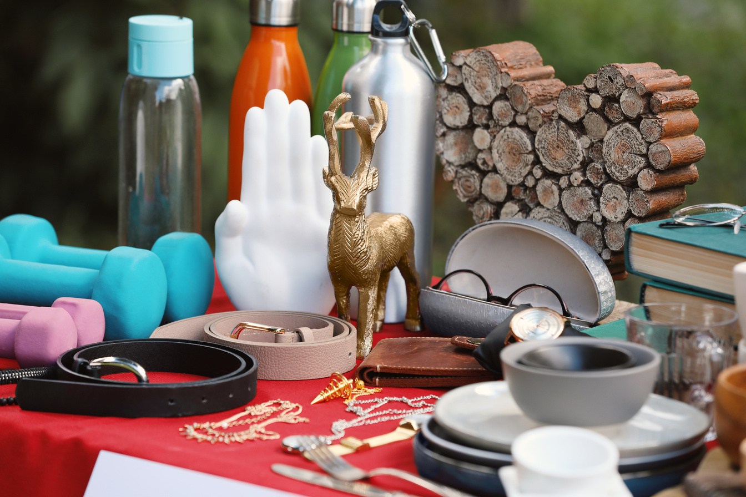
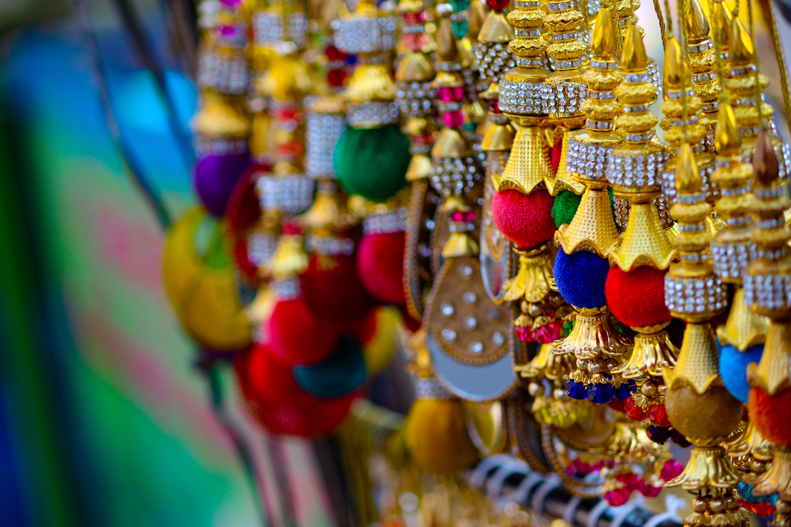
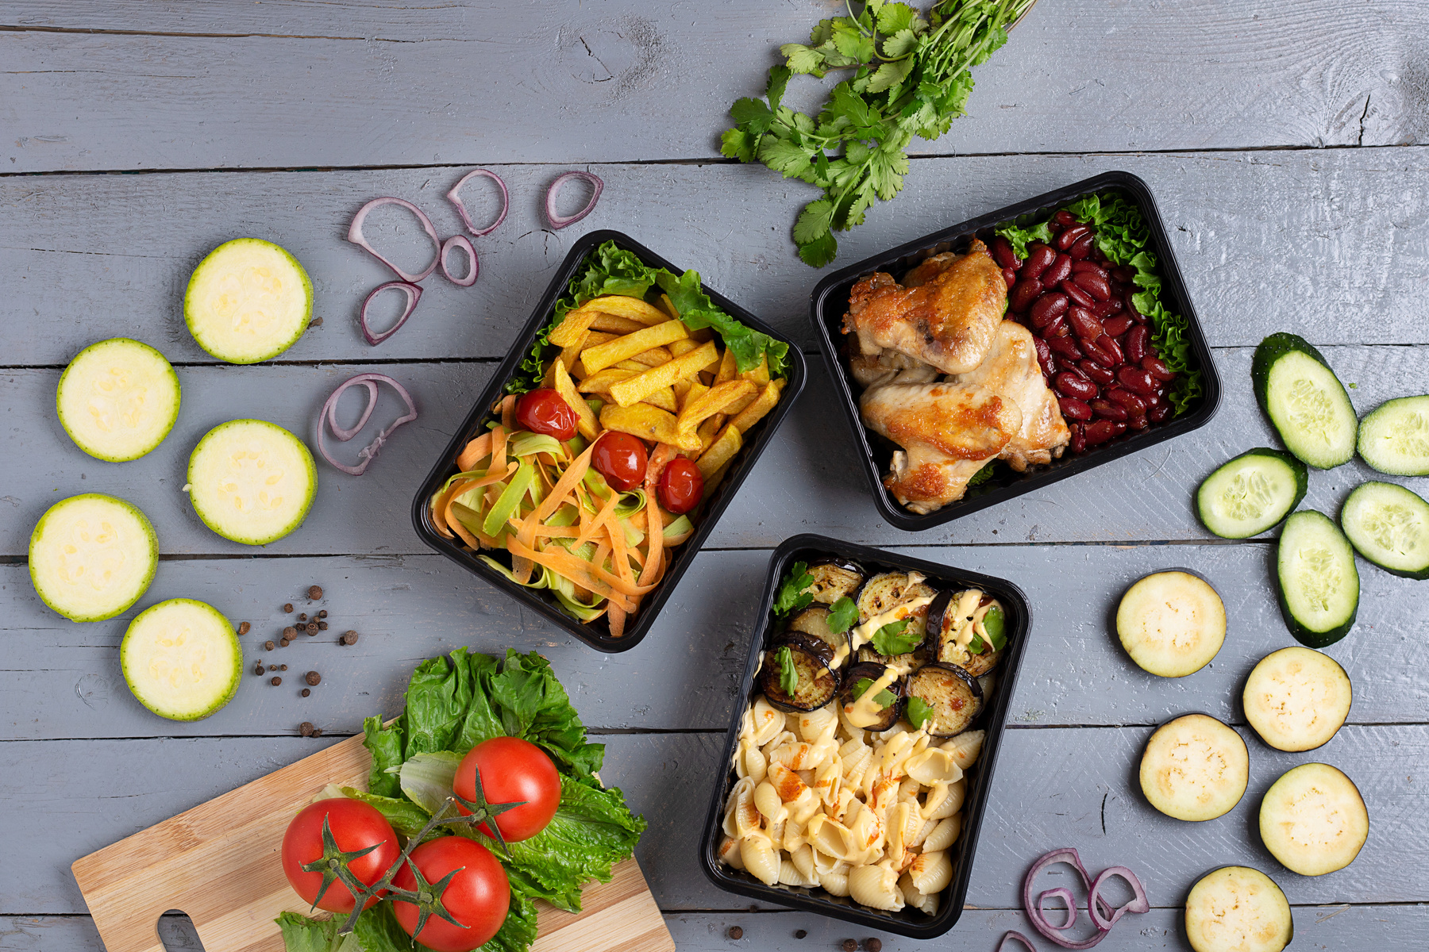
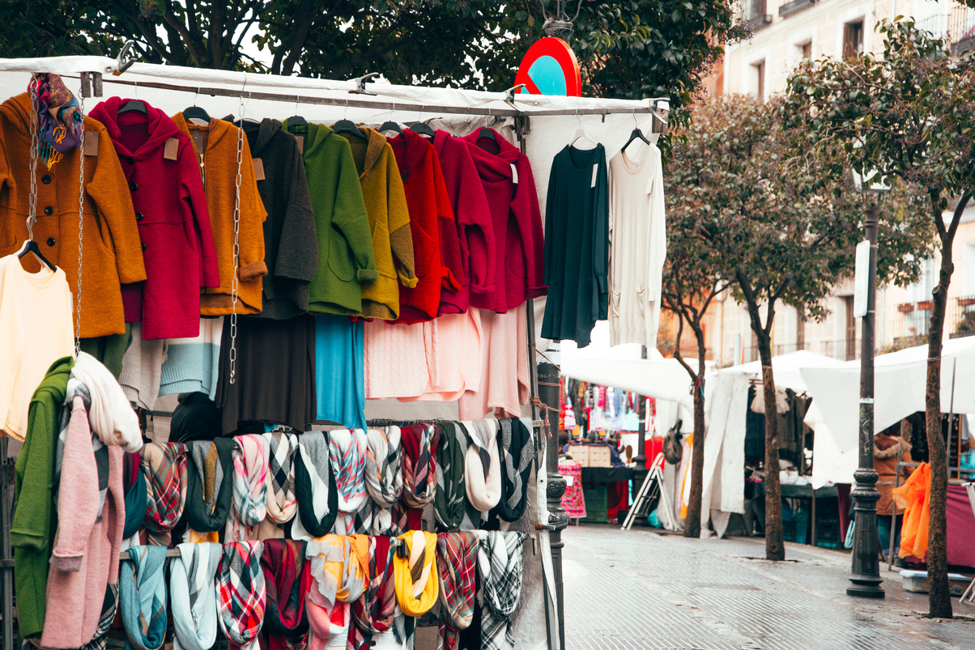
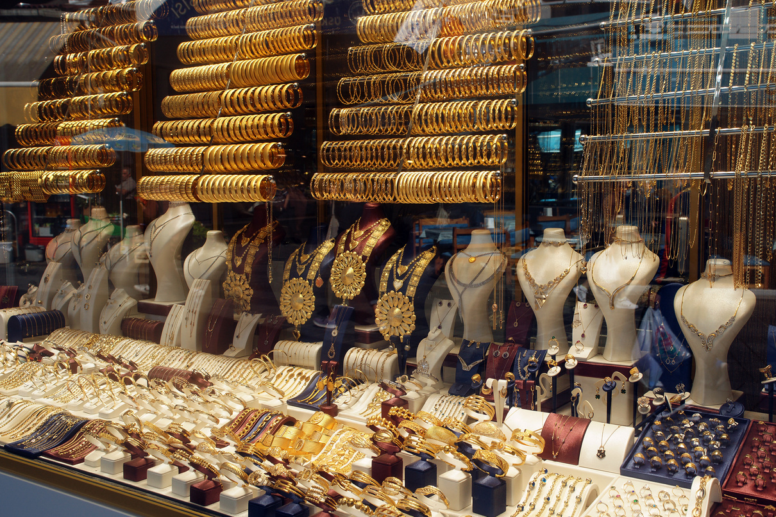
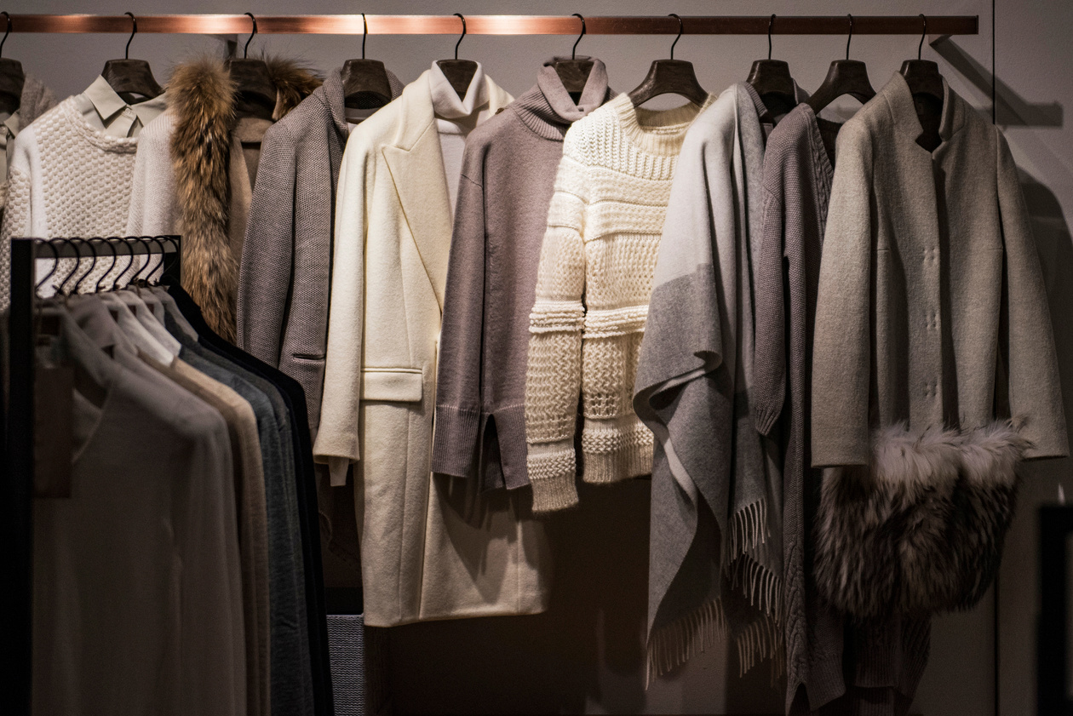
Embrace the spectrum with an assortment!
A tapestry of treasures, spanning from exquisite home decor, apparel, and jewelry to homemade culinary delights.
Crafted Charm
Discover handcrafted fashion, unique decor, dazzling jewelry, and homemade delights — all under one Indian sky!
India Blend
Immerse in the city's vibrant spirit, where cultures collide, and communities connect at our weekend flea market extravaganza.
Entertain & Shop
Experience more than just shopping! Live music, DIY fun, and delicious bites await for a weekend of entertainment and local treasures.
Notes:
2

Slide 3


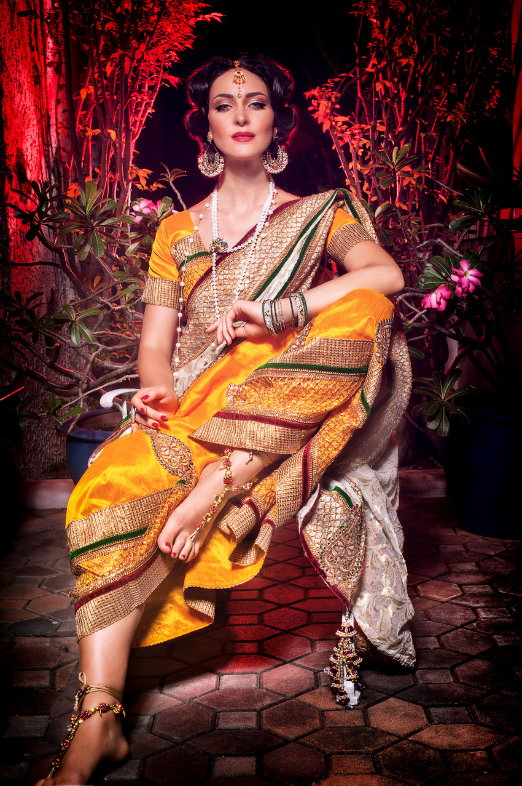

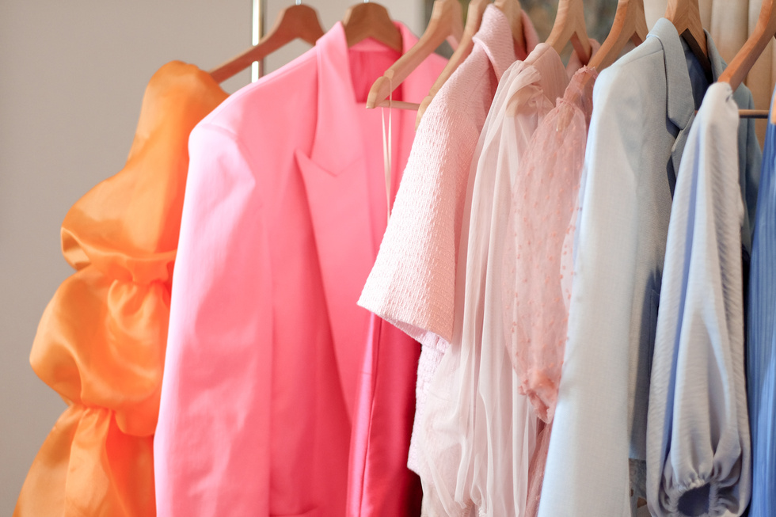
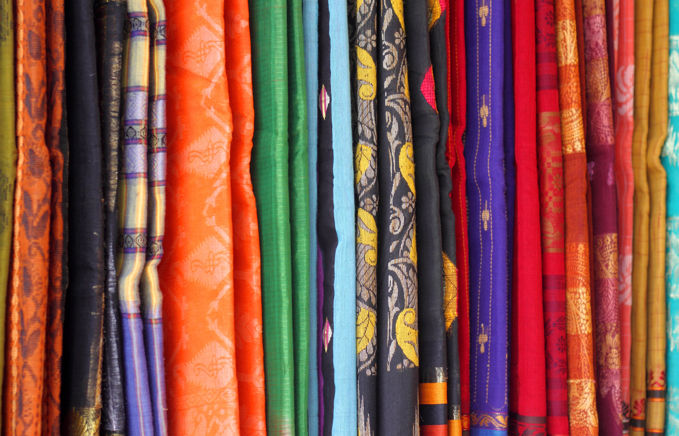
"Threads of India: India's Stylish Delights Unveiled!"
Get ready to be swept away by Indian Fashion Wonderland, where every garment holds a tale of style and flair, woven by skilled artisans, and all set to dazzle your wardrobe!
Garments of Enchantment
Bedazzle with elegance and poise.
Notes:
3

Slide 4
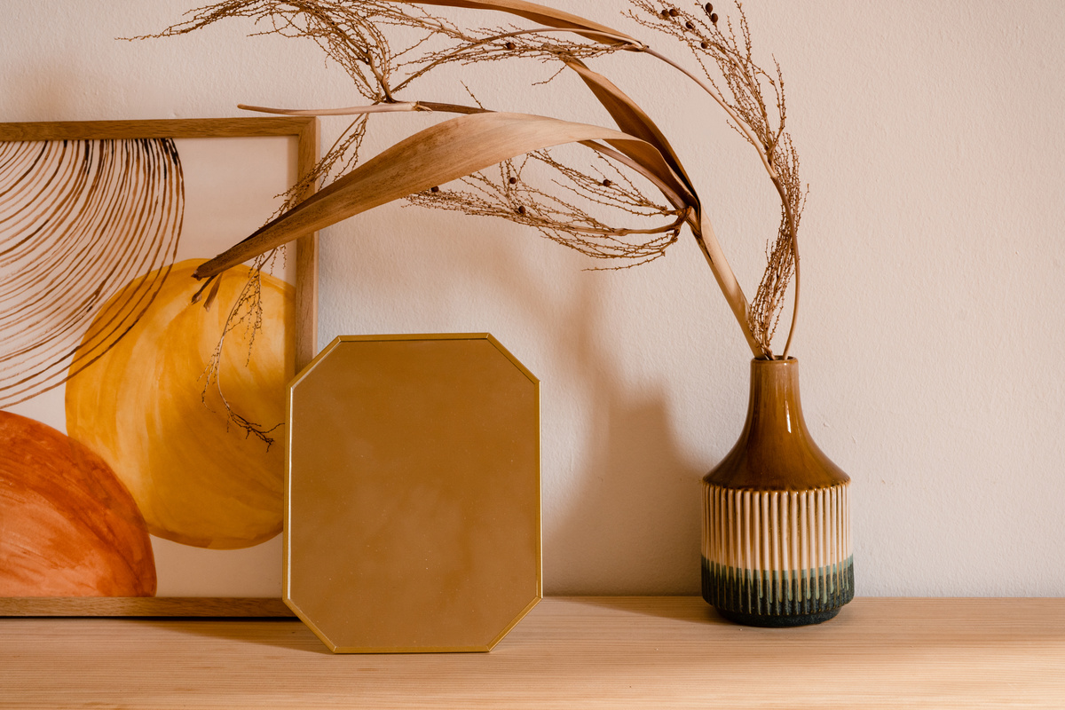

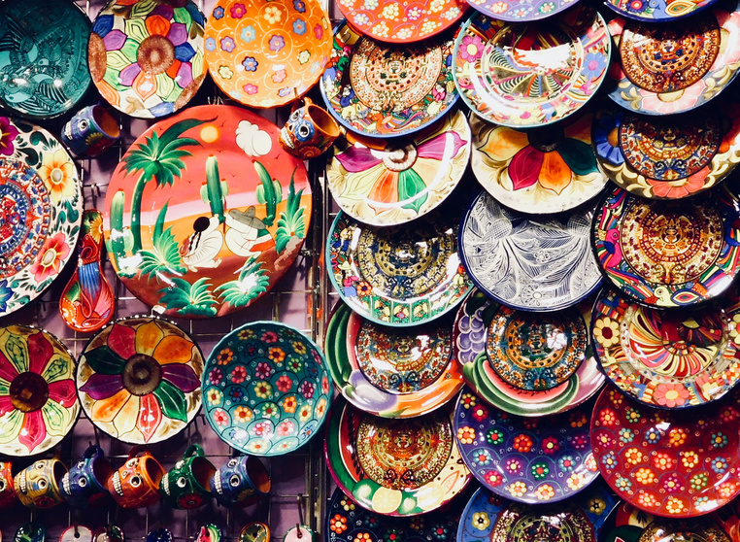
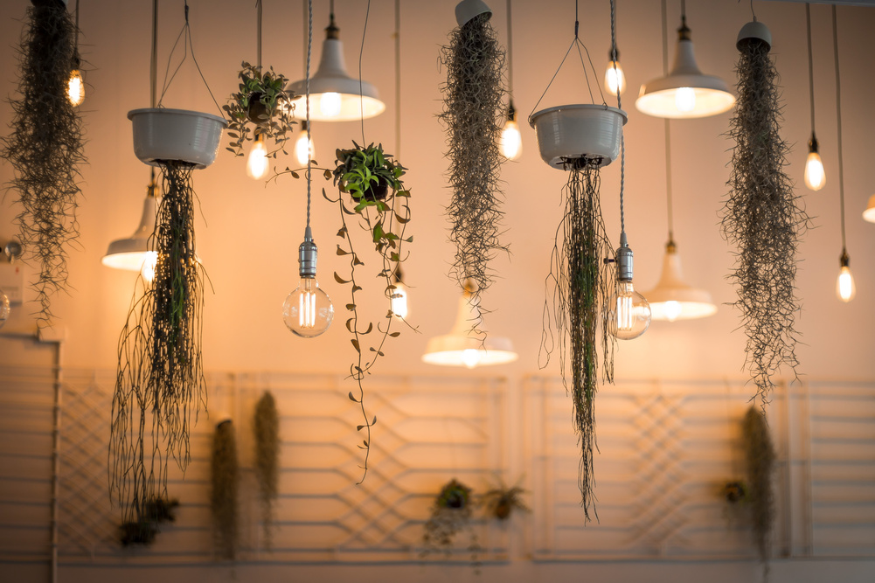
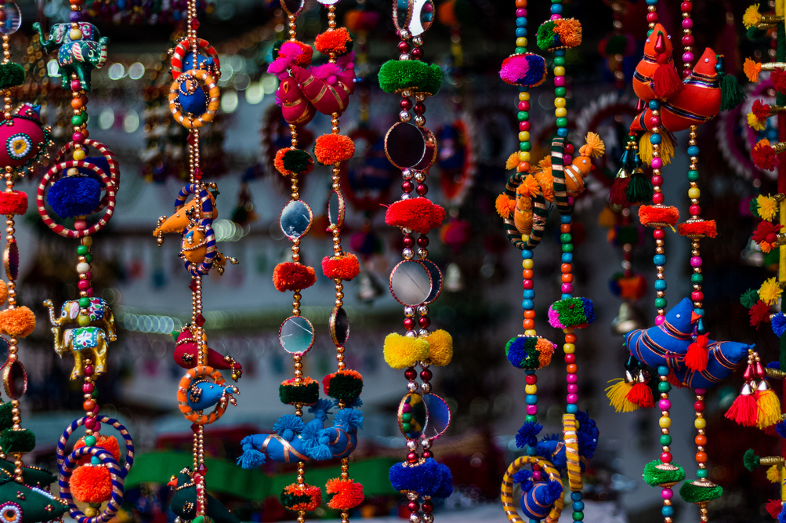
"Home Elegance & Culinary Bliss: Indian Décor and Homemade Delights Await!"
"Transform Spaces with Local Flair and Savor India's Homemade Delicacies – A Perfect Fusion of Style and Flavorful Comfort."
Ornate, Inviting, Chic.
Artisanal decor exudes beauty.
Notes:
3

Slide 5
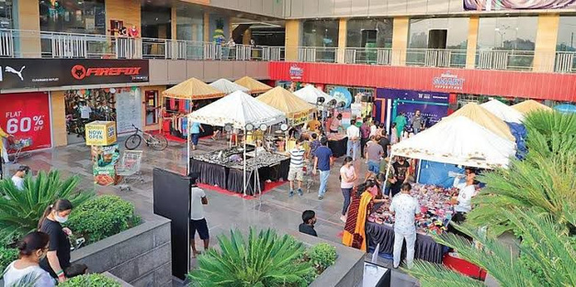
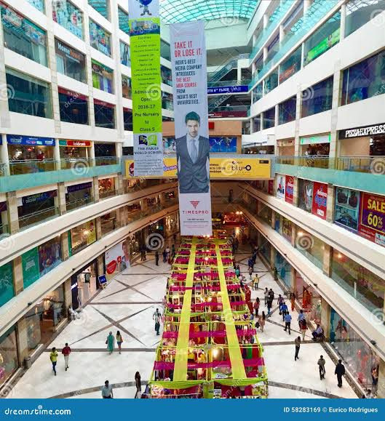
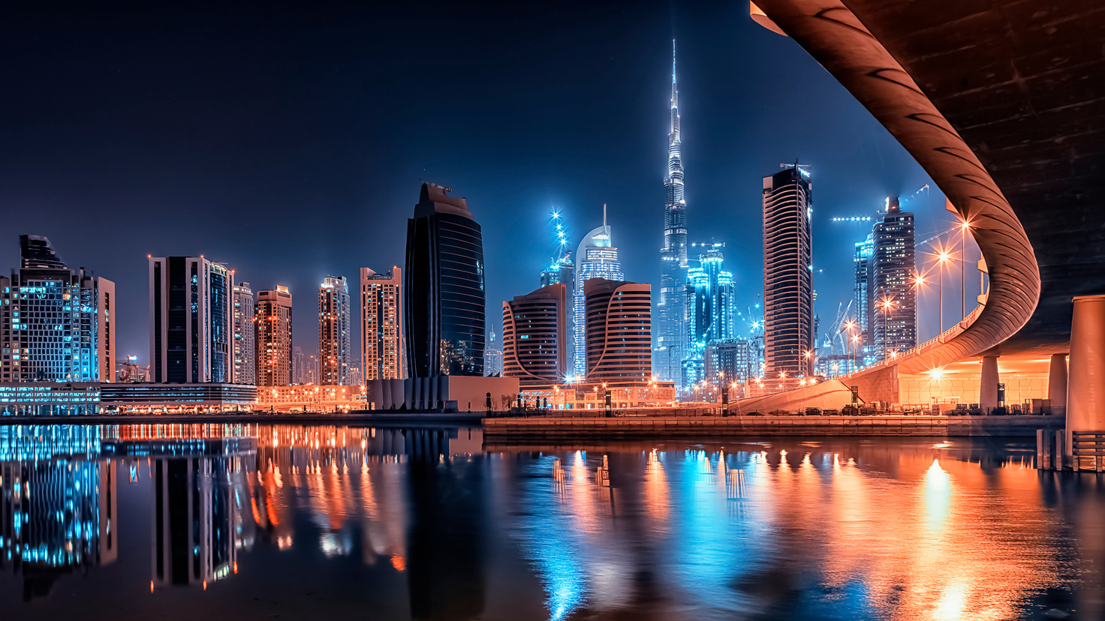
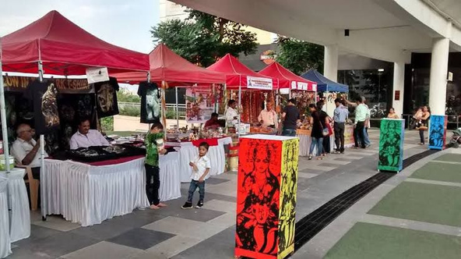

"Timeless Treasures: Reliving the Magic of Past Events"
"Step into the Nostalgia: A Glimpse Back at Unforgettable Moments, Laughter, and Surprises from Our Previous Spectacular Events in Dubai."
Dubai Delights Elegant Experiences.
Global Glamour Dazzling Diversity.
**Please note that these images serve as a reference for the actual flea market. They can be customized and redesigned based on the provided location.**
Notes:
3

Slide 6
"Indian Unveiled: Discover, Indulge, Experience the Delightful Fusion of Weekend Wonders!"
"Dive into the Heart of India's Extravaganza: A Tapestry of Finds, Flavors, and Fun Await Every Visitor's Curiosity!"
Hidden Gems
Unique, undiscovered finds.
Flavorful Bites
Mouthwatering homemade treats.
Interactive Corners
Engaging, fun experiences.
Notes:
4

Slide 7
Chanxe Solutions: Elevating Your Spaces
Transform Your Environment into a Haven of Sophistication and Beauty
Discover how we can assist you in achieving this goal by getting in touch with us! Check out our booth if you're in India, or simply contact us for further information.
INDIA
CONTACT FOR SPONSORSHIP &TABLE BOOKING :
0563842601 OR Chanxesolutions@gmail.com
or visit www.chanxe.vercel.app
Notes:
6

